Slide 1
BCSE103E - Computer Programming: Java
Dr. S. A. AMUTHA JEEVAKUMARI
Assistant Professor (Sr.)
School of Computer Science and Engineering
VIT - Chennai

Slide 2

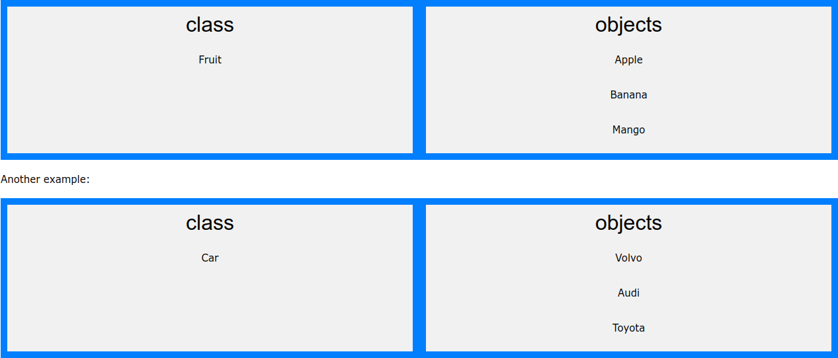
Java - What are Classes and Objects?
Classes and Objects are the two main aspects of OOP.
Classes is a template for Objects , and an Object is an instance of a Class.
When the individual Objects are created, they inherit all the variables and methods from the Class.

Slide 3
Java Classes...
Java is an object-oriented programming language.
Everything in Java is associated with classes and objects, along with its attributes and methods. For example: in real life, a car is an object. The car has attributes, such as weight and color, and methods, such as drive and brake.
A Class is like an object constructor, or a "blueprint" for creating objects. Create a Class : (Syntax)
public class Dog {
String breed, color
int age;
void barking() { void hungry() { void sleeping() {
// Member Data
}
}
}
// Member Methods
}

Slide 4
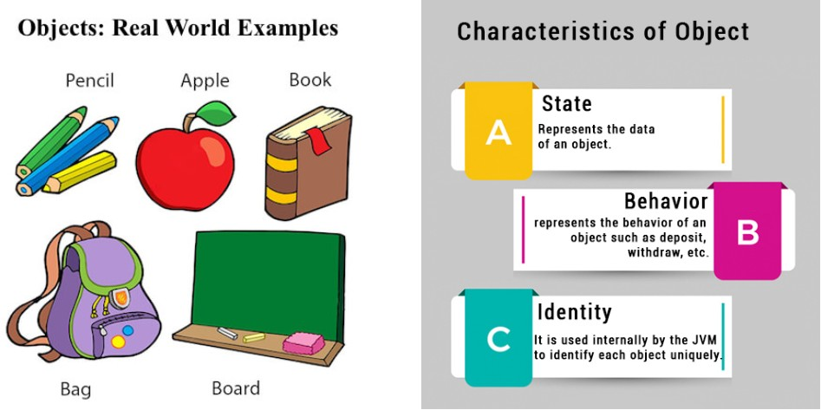
Java Objects

Slide 5
Java Objects...
In Java, an object is created from a class.
We have already created the class named Dog, so now we can use this to create objects (Dog1, Dog2, Dog3 So on....)
public class Dog {
String breed, color
int age;
void barking() { void hungry() { void sleeping() {
// Member Data/Attributes
// Member Methods
}
}
}
public static void main(String[] args) { Dog Dog1 = new Dog(); System.out.println(Dog1.breed); System.out.println(Dog1.color);
Dog Dog2 = new Dog(); System.out.println(Dog2.breed); System.out.println(Dog2.color);
}
// Dog1 is Created
// Dog2 is Created
}

Slide 6
Accessing or Modify Attributes/Methods
Can access attributes by creating an object of the class, and by using the dot syntax (.)
Another term for class attributes is fields.
public class Main {
int x;
public static void main(String[] args) { Main myObj = new Main();
myObj.x = 40; System.out.println(myObj.x);
// Modifying
// Accessing
}
}

Slide 7
Example : Java Classes/Objects... I
// Class Declaration
public class Dog
{
// Instance Variables
String name; String breed; int age; String color;
// Constructor Declaration of Class
public Dog(String name, String breed,
int age, String color)
{
this.name = name; this.breed = breed; this.age = age; this.color = color;
}

Slide 8
Example : Java Classes/Objects... II
// method 1
public String getName()
{
return name;
}
// method 2
public String getBreed()
{
return breed;
}
// method 3
public int getAge()
{
return age;
}
// method 4
10/ 130

Slide 9
Example : Java Classes/Objects... III
public String getColor()
{
return color;
}
@Override
public String toString()
{
return("Hi my name is "+ this.getName()+ ".\nMy breed,age and color are " + this.getBreed()+"," + this.getAge()+ ","+ this.getColor());
}
public static void main(String[] args)
{
Dog tuffy = new Dog("tuffy","papillon", 5, "white"); System.out.println(tuffy.toString());
}
}

Slide 10
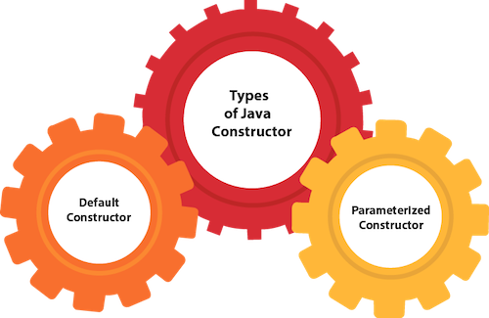
Java Constructors
In Java, a constructor is a block of codes similar to the method.
It is called when an instance of the class is created. At the time of calling constructor, memory for the object is allocated in the memory.
It is a special type of method which is used to initialize the object.
Every time an object is created using the new() keyword, at least one constructor is called.
Rules for creating constructor :
Constructor name must be the same as its class name
A Constructor must have no explicit return type
A Java constructor cannot be abstract, static, final, and synchronized.
Constructor Types :

Slide 11
Default Constructor
A constructor is called "Default Constructor" when it doesn’t have any parameter. Rule: If there is no constructor in a class, then compiler automatically creates a default constructor.
Syntax :
<class_name>(){}
Example :
//Java Program to create and call a default constructor
class Bike1{
//creating a default constructor
Bike1(){
System.out.println("Bike is created");
}
//main method
public static void main(String args[]){
//calling a default constructor
Bike1 b=new Bike1();
}
}

Slide 12
Example - Default Constructor
Purpose of Default Constructor
It used to provide the default values to the object like 0, null, etc.,.
//Default constructor which displays the default values
class Student{
int id;
String name;
//method to display the value of id and name
void display(){System.out.println(id+" "+name);}
public static void main(String args[]){
//creating objects Student s1=new Student(); Student s2=new Student();
//displaying values of the object
s1.display();
s2.display();
}
}
// 0 null
// 0 null

Slide 13
Parameterized Constructor
A constructor which has a specific number of parameters. It is used to provide different values to distinct objects.
//Default constructor which displays the default values
class Student{
int id;
String name;
//creating a parameterized constructor
Student(int i,String n){ id = i; name = n; }
//method to display the value of id and name
void display(){System.out.println(id+" "+name);}
public static void main(String args[]){ Student s1=new Student(50396, "Pradeep");
Student s2=new Student(50394, "Nachiyappan");
//displaying values of the object
s1.display(); s2.display();
}
}
// 50396, Pradeep
// 50394, Nachiyappn

Slide 14
Example - Default Constructors
// Create a Main class
public class Main {
// Create a class attribute
int x;
// Create a class constructor for the Main class
public Main() {
// Set the initial value for the class attribute x
x = 5;
}
public static void main(String[] args) {
// Create an object of class Main
//(This will call the constructor)
Main myObj = new Main();
// Print the value of x
System.out.println(myObj.x);
}
}

Slide 15
Example - Parameterized Constructors
// Example of Parameterized Constructor
public class Main { int modelYear; String modelName;
public Main(int year, String name) { modelYear = year;
modelName = name;
}
public static void main(String[] args) {
Main myCar = new Main(2020, "Grandi10-NIOS"); System.out.println(myCar.modelYear + " " + myCar.modelName);
}
}
// Outputs : 1969 Grandi10-NIOS

Slide 16
Method Overloading
Multiple methods in a class, can have the same name with different parameters
To perform only one operation, having same name of the methods increases the readability of the program.
For Example : To perform addition of the given numbers but there can be any number of arguments, if you write the method such as func1(int,int) for two parameters, and func2(int,int,int) for three parameters then it may be difficult for you as well as other programmers to understand the behavior of the method because its name differs.
Advantage : Increases the readability of the program. Ways to Overload :
By changing number of arguments By changing the data type
Note : Method Overloading isn’t possible by changing the method return type only.

Slide 17
Example : Method OverLoading
class Adder{
// 2 Arguments of Integer Data type
static int add(int a, int b){return a+b;}
// 3 Argument of Interger Data type
static int add(int a, int b, int c){return a+b+C;}
// 2 Argument of Double Data type
static double add(double a, double b){return a+b;}
}
class TestOverloading{
public static void main(String[] args){ System.out.println(Adder.add(11,11)); System.out.println(Adder.add(11,12,13)) System.out.println(Adder.add(12.3,12.6));
}
}
// Output : 22, 36, 24.9

Slide 18
Method OverLoading....!
Can we overload java main() method?
Answer : Yes
class TestOverloading{
public static void main(String[] args){ System.out.println("main with String[]");
}
public static void main(String args){ System.out.println("main with String");
}
public static void main(){
System.out.println("main without args");
}
}
// Output : main with String[]
JVM calls main() method which receives string array as arguments only.

Slide 19
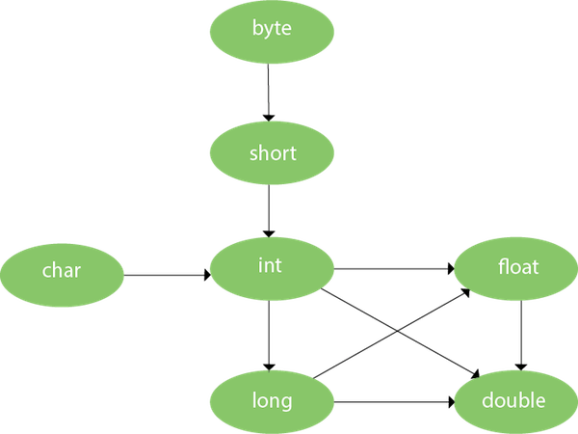
Method Overloading and Type Promotion

Slide 20
Examples - Method Overloading
//Example of Method Overloading with TypePromotion
class OverloadingCalculation{
void sum(int a,long b){System.out.println(a+b);}
void sum(int a,int b,int c){System.out.println(a+b+c);}
public static void main(String args[]){ OverloadingCalculation obj=new OverloadingCalculation();
obj.sum(20,20);//now second int literal will be promoted to long
obj.sum(20,20,20);
}
}
//Example of Method Overloading with Type Promotion if matching found
class OverloadingCalculation{
void sum(int a,int b){System.out.println("int arg method invoked");}
void sum(long a,long b){System.out.println("long arg method invoked");}
public static void main(String args[]){ OverloadingCalculation obj=new OverloadingCalculation();
obj.sum(20,20); //now int arg sum() method gets invoked
}
}

Slide 21
Examples - Method Overloading
Ambiguity : If there are no matching type arguments in the method, and each method promotes similar number of arguments, there will be ambiguity.
//Example of Method Overloading with Type Promotion in case of ambiguity
class OverloadingCalculation{
void sum(int a,long b){System.out.println("a method invoked");} void sum(long a,int b){System.out.println("b method invoked");} public static void main(String args[]){
OverloadingCalculation obj=new OverloadingCalculation(); obj.sum(20,20);//now ambiguity
}
}
// Output:Compile Time Error

Slide 22
Constructor Overloading
In Java, a constructor is just like a method but without return type.
It can also be overloaded like Java methods.
It is a technique of having more than one constructor with different parameter lists.
They are arranged in a way that each constructor performs a different task.
They are differentiated by the compiler by the number of parameters in the list and their types.

Slide 23
Examples - Constructor Overloading
//Java program to overload constructors
class Student{ int id, age; String name;
Student(int i,String n){ id = i; name = n;
}
// creating two arg constructor
Student(int i,String n,int a){ //creating three arg constructor
id = i; name = n; age=a;
}
void display(){System.out.println(id+" "+name+" "+age);}
public static void main(String args[]){
Student s1 = new Student(396,"Pradeep K V"); Student s2 = new Student(397,"Aryan",25);
s1.display();
s2.display();
}
}
/* Output : 396, Pradeep K V
397, Aryan, 25
*/

Slide 24
Examples - Constructor Overloading I
// Java program to illustrate Constructor Overloading
class Box {
double width, height, depth;
// constructor used when all dimensions specified
Box(double w, double h, double d) {
width = w; height = h; depth = d;
}
// constructor used when no dimensions specified
Box() {
width = height = depth = 0;
}
// constructor used when cube is created
Box(double len) {
width = height = depth = len;
}
// compute and return volume
double volume() {
return width * height * depth;
}
}

Slide 25
Examples - Constructor Overloading II
// Driver code
public class Test {
public static void main(String args[]) {
// create boxes using the various constructors
Box mybox1 = new Box(10, 20, 15); Box mybox2 = new Box();
Box mycube = new Box(7);
double vol;
// get volume of first box
vol = mybox1.volume();
System.out.println(" Volume of mybox1 is " + vol);
// get volume of second box
vol = mybox2.volume();
System.out.println(" Volume of mybox2 is " + vol);
// get volume of cube
vol = mycube.volume();
System.out.println(" Volume of mycube is " + vol);
}
}

Slide 26
Differences b/w Constructor and Methods in Java
Java Constructor | Java Method
A constructor is used to initialize the state of an object. | A method is used to expose the behavior of an object.
A constructor must not have a return type. | A method must have a return type.
The constructor is invoked implicitly. | The method is invoked explicitly.
The Java compiler provides a default constructor, if you don’t have any constructor in a class. | The method is not provided by the compiler in any case.
The constructor name must be same as the class name. | The method name may or may not be same as the class name.

Slide 27
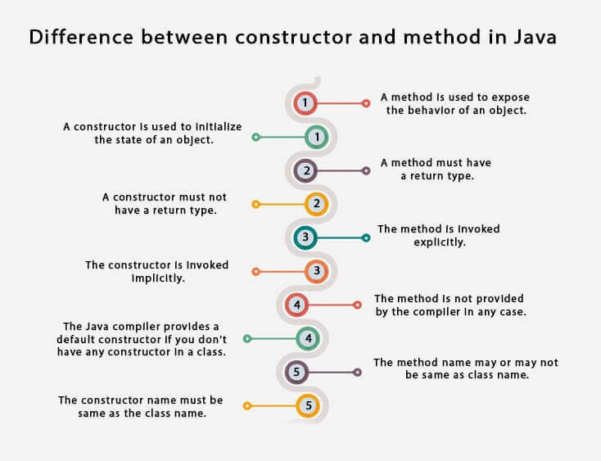
Differences b/w Constructor and Methods in Java

Slide 28
Java Copy Constructor
There is no copy constructor in Java. However, we can copy the values from one object to another like copy constructor in C++.
There are many ways to copy the values of one object into another in Java.
By constructor
By assigning the values of one object into another. By clone() method of Object class.
Important Questions -
Does constructor return any value? (Ans : Yes)
Can constructor perform other tasks instead of initialization? (Ans : Yes) Is there Constructor class in Java? (Ans : Yes)

Slide 29
Example-1 - By constructor
//Java program to initialize the values from one object to another object.
class Student{ int id; String name;
//constructor to initialize integer and string
Student(int i,String n){ id = i; name = n;
}
//constructor to initialize another object
Student(Student s){
id = s.id; name =s.name;
}
void display(){System.out.println(id+" "+name);}
public static void main(String args[]){ Student s1 = new Student(396,"Deepu"); Student s2 = new Student(s1); s1.display();
s2.display();
}
}
/* Output : 396, Deepu
*
396, Deepu

Slide 30
Example-2 - By assigning
//Java program to assign the values from one object to another object.
class Student{ int id; String name;
Student(int i,String n){ id = i; name = n;
}
Student(){}
void display(){System.out.println(id+" "+name);}
public static void main(String args[]){ Student s1 = new Student(396,"Deepu"); Student s2 = new Student();
s2.id=s1.id; s2.name=s1.name; s1.display(); s2.display();
}
}
/* Output : 396, Deepu
*
396, Deepu

Slide 31
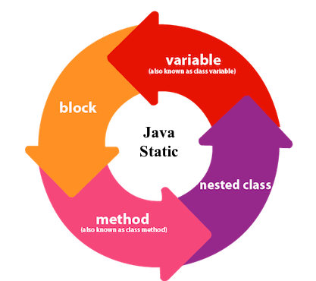
Java static Keyword
is used for memory management mainly.
The static keyword belongs to the class than an instance of the class.
static can be:
Variable (also known as a class variable) Method (also known as a class method) Block
Nested class

Slide 32
1.. Java static variable
Any variable, declared as static, known as a static variable.
The static variable can be used to refer to the common property of all objects (which is not unique for each object).
For Eg:- the company name of employees, college name of students, etc.
The static variable gets memory only once in the class area at the time of class loading.
Advantages :- It makes your program memory efficient (i.e., it saves memory).
Java static property is shared to all objects.
Understanding the problem without static variable:
class Student{
int rollno; String name; String college = "VIT";
}
Suppose there are 500 students in my college, now all instance data members will get memory each time when the object is created. All students have
its unique rollno and name, so instance data member is good in such case.
Here, "college" refers to the common property of all objects. If we make it static, this field will get the memory only once.

Slide 33

//Java Program to demonstrate the use of static variable
class Student{
int rollno; String name;
static String college ="VIT";
//constructor
Student(int r, String n){ rollno = r;
name = n;
}
//instance variable
//static variable
//method to display the values
void display (){System.out.println(rollno+" "+name+" "+college);}
}
//Test class to show the values of objects
public class TestStaticVariable1{
public static void main(String args[]){ Student s1 = new Student(396,"Deepu"); Student s2 = new Student(397,"Swetha");
//we can change the college of all objects by the single line of code
//Student.college="BBDIT";
s1.display();
s2.display();
}
}

Slide 34
Program of the counter without static variable
//Java Program to demonstrate the use of an instance variable
//which get memory each time when we create an object of the class.
class Counter{
//will get memory each time when the instance is created
int count=0;
Counter(){
count++; //incrementing value
System.out.println(count);
}
public static void main(String args[]){
//Creating objects
Counter c1=new Counter(); Counter c2=new Counter(); Counter c3=new Counter();
}
}
// 1 1 1

Slide 35
Program of the counter with static variable
//Java Program to illustrate the use of static variable which
//is shared with all objects.
class Counter{
//will get memory only once and retain its value
static int count=0;
Counter(){
//incrementing the value of static variable
count++; System.out.println(count);
}
public static void main(String args[]){
//creating objects Counter c1=new Counter(); Counter c2=new Counter(); Counter c3=new Counter();
}
}
// Output : 1 2 3

Slide 36
2.. Java static method I
It belongs to the class rather than the object of a class.
It can be invoked without the need for creating an instance of a class. It can access static data member and can change the value of it.
//Java Program to demonstrate the use of a static method.
class Student{
int rollno;
String name;
static String college = "VIT";
//static method to change the value of static variable
static void change(){ college = "Vellore";
}
//constructor to initialize the variable
Student(int r, String n){ rollno = r;
name = n;
}

Slide 37
2.. Java static method II
//method to display values
void display(){
System.out.println(rollno+" "+name+" "+college);
}
}
//Test class to create and display the values of object
public class TestStaticMethod{
public static void main(String args[]){
Student.change();//calling change method
//creating objects
Student s1 = new Student(111,"Shanthi"); Student s2 = new Student(222,"Kranthi"); Student s3 = new Student(333,"Branthi");
//calling display method
s1.display(); s2.display(); s3.display();
}
}
Output:111 Shanthi Vellore
222 Kranthi Vellore
333 Branthi Vellore

Slide 38
Java static Keyword....
Restrictions for the static method
The static method can not use non static data member or call non-static method directly.
this and super cannot be used in static context.
class A{
int a=40; //non static
public static void main(String args[]){ System.out.println(a);
}
}
// Compilation Error

Slide 39
3.. Java static block
Is used to initialize the static data member.
It is executed before the main method at the time of classloading.
class A{ static{
System.out.println("static block is invoked");
}
public static void main(String args[]){ System.out.println("Hello main");
}
}
/* Output:static block is invoked
Hello main */
Can we execute a program without main() method? –> No

Slide 40
Java this Keyword
There can be a lot of usage of java this keyword. In java, this is a reference variable that refers to the current object.
this can be used to refer current class instance variable. this can be used to invoke current class method (implicitly) this() can be used to invoke current class constructor.
this can be passed as an argument in the method call.
this can be passed as argument in the constructor call.
this can be used to return the current class instance from the method.
The most common use of the this keyword is to eliminate the confusion between class attributes and parameters with the same name.
To distinguish local variable and instance variable.

Slide 41
Example-1. (Problem without this)
// Understanding the problem without this keyword
class Student{
int rollno; String name; float fee;
Student(int rollno,String name,float fee){ rollno=rollno; name=name; fee=fee;
}
void display() { System.out.println(rollno+" "+name+" "+fee); }
}
class TestThis1{
public static void main(String args[]){ Student s1=new Student(111,"ankit",5000f); Student s2=new Student(112,"sumit",6000f); s1.display();
s2.display();
}
}
/*
0 null 0.0
* 0 null 0.0 */

Slide 42
Example-2. (Solution)
// Solution of the above problem by this keyword
class Student{
int rollno; String name; float fee;
Student(int rollno,String name,float fee){ this.rollno=rollno; this.name=name; this.fee=fee;
}
void display() { System.out.println(rollno+" "+name+" "+fee); }
}
class TestThis1{
public static void main(String args[]){ Student s1=new Student(111,"ankit",5000f); Student s2=new Student(112,"sumit",6000f); s1.display();
s2.display();
}
}
/*
111 ankit 5000
112 sumit 6000 */

Slide 43
Example-3.(Not required this)
// If local variables(formal arguments) and instance variables are different,
// there is no need to use this keyword like in the following program:
class Student{
int rollno; String name; float fee;
Student(int r,String n, float f{ rollno=r; this.name=n; fee=f;
}
void display() { System.out.println(rollno+" "+name+" "+fee); }
}
class TestThis1{
public static void main(String args[]){ Student s1=new Student(111,"ankit",5000f); Student s2=new Student(112,"sumit",6000f); s1.display();
s2.display();
}
}
/*
111 ankit 5000
112 sumit 6000 */

Slide 44
2.. this to invoke current class method
To invoke the method of the current class by using the this keyword. If you don’t use the this keyword, compiler automatically adds this keyword while invoking the method.
class A{
void m(){ System.out.println("hello m"); }
void n(){
System.out.println("hello n");
//m();//same as this.m()
this.m();
}
}
class TestThis4{
public static void main(String args[]){ A a=new A();
a.n();
}
/* hello n
* hello m */
}

Slide 45
3.. this to invoke class Default Constructor
The this() constructor call can be used to invoke the current class constructor. It is used to reuse the constructor. In other words, it is used for constructor chaining.
// Default Constructor
class A{
A(){ System.out.println("hello a"); } A(int x){
this(); System.out.println(x);
}
}
class TestThis{
public static void main(String args[]){ A a=new A(10);
}
}
/*
hello a
* 10
*/

Slide 46
3.. this to invoke class Parameterized Constructor
The this() constructor call can be used to invoke the current class constructor. It is used to reuse the constructor.
// Parametrized Constructor
class A{ A(){
this(5); System.out.println("hello a");
}
A(int x){ System.out.println(x); }
}
class TestThis6{
public static void main(String args[]){ A a=new A();
}
}
/*
5
* hello a */
48/ 130

Slide 47
Real usage of this() constructor call
class Student{
int rollno; String name,course;
float fee;
Student(int rollno,String name,String course){ this.rollno=rollno; this.name=name; this.course=course;
}
Student(int rollno,String name,String course,float fee){ this(rollno,name,course); //reusing constructor this.fee=fee;
}
void display(){
System.out.println(rollno+" "+name+" "+course+" "+fee);
}
}
class TestThis{
public static void main(String args[]){
Student s1=new Student(111,"ankit","java"); Student s2=new Student(112,"sumit","java",6000f); s1.display(); s2.display();
}
/* 111 ankit java null
}
* 112 sumit java 6000 */

Slide 48
Real usage of this() constructor call
Rule: Call to this() must be the first statement in constructor.
class Student{
int rollno; String name,course;
float fee;
Student(int rollno,String name,String course){ this.rollno=rollno; this.name=name; this.course=course;
}
Student(int rollno,String name,String course,float fee){
this.fee=fee; this(rollno,name,course); //C.T.Error
}
void display(){
System.out.println(rollno+" "+name+" "+course+" "+fee);
}
}
class TestThis{
public static void main(String args[]){ Student s1=new Student(111,"ankit","java");
Student s2=new Student(112,"sumit","java",6000f);
s1.display(); s2.display();
}
}
/* Compile Time Error:
* Call to this must be first statement in constructor */

Slide 49
4.. this to pass as an argument in the method
It can also be passed as an argument in the method. It is mainly used in the event handling.
class S2{
void m(S2 obj){
System.out.println("method is invoked");
}
void p(){
m(this);
}
public static void main(String args[]){ S2 s1 = new S2();
s1.p();
}
}
/* method is invoked */

Slide 50
5.. this to pass as argument in the constructor call
It can pass as an argument in the constructor also. It is useful if we have to use one object in multiple classes.
class B{ A4 obj;
B(A4 obj){ this.obj=obj; } void display(){
System.out.println(obj.data);
}
}
class A4{
//using data member of A4 class
int data=10;
A4(){ B b=new B(this); b.display(); }
public static void main(String args[]){ A4 a=new A4();
}
}
/* Output:10 */

Slide 51
6.. this keyword can be used to return current class instance
We can return this keyword as an statement from the method. In such case, return type of the method must be the class type (non-primitive)
class A{
A getA(){ return this;
}
void msg(){
System.out.println("Hello java");}
}
class Test1{
public static void main(String args[]){ new A().getA().msg();
}
}
// Hello java

Slide 52
Access Specifiers
Modifiers in Java are of two types:
Access Modifiers
Access modifiers in Java allow us to set the scope or accessibility or visibility of a data member (method or field) be it a field, constructor, class, or method.
Non-access Modifiers
Java also provides non-access specifiers that are used with classes, variables, methods, constructors, etc. The non-access specifiers/modifiers define the behavior of the entities to the JVM.

Slide 53
Java Modifiers (Specifiers)
Modifiers are keywords used to change their meanings. Java has a wide variety of modifiers, including the following:
Access Modifiers : to set access levels for classes, variables, methods and
constructors. The four access levels are :
default : Visible to the package private : Visible to the class only public : Visible to the world.
protected : Visible to the package and all subclasses.
Non Access Modifiers :
static : used for creating class methods and variables.
final : used for finalizing the implementations of classes, methods, variables.
abstract : used for creating abstract classes and methods.
synchronized and volatile modifiers, which are used for threads.

Slide 54
Java Modifiers....
Table: Understanding Access Modifers
Access Modifier | within class | within package | outside package by subclass only | outside package
Private | Y | N | N | N
Default | Y | Y | N | N
Protected | Y | Y | Y | N
Public | Y | Y | Y | Y

Slide 55
private Access Modifier
The private access modifier is accessible only within the class.
class A{
private int data=40;
private void msg(){System.out.println("Hello java");}
}
public class Simple{
public static void main(String args[]){ A obj=new A();
System.out.println(obj.data); obj.msg();
}
//Compile Time Error
//Compile Time Error
}

Slide 56
private Access Modifier
The private access modifier is accessible only within the class.
public class Simple{ private int data=40;
private void msg(){System.out.println("Hello java");}
public static void main(String args[]){ Simple obj=new Simple();
System.out.println(obj.data); obj.msg();
}
//No Compile Time Error
//No Compile Time Error
}
/* Output : 40
*
Hello java */

Slide 57
private Access Modifier
Role of Private Constructor
If you make any class constructor private, you cannot create the instance of that class from outside the class.
For Example :
class A{
private A(){}//private constructor
void msg(){System.out.println("Hello java");}
}
public class Simple{
public static void main(String args[]){
A obj=new A(); //Compile Time Error
}
}

Slide 58
default Access Modifier
If you don’t use any modifier, it is treated as default by default.
It is accessible only within package.
It cannot be accessed from outside the package.
It provides more accessibility than private. But, it is more restrictive than protected, and public.
//save by A.java
package pack;
class A{ void msg() { System.out.println("Hello"); } }
//save by B.java package mypack; import pack.*; class B{
public static void main(String args[]){
A obj = new A(); obj.msg();
//Compile Time Error
//Compile Time Error
}
}
The scope of class A and its method msg() is default so it cannot be accessed from outside the package.

Slide 59
protected Access Modifier
Created the two packages pack and mypack. The A class of pack package is public, so can be accessed from outside the package. But msg() of this package is declared as protected, so it can be accessed from outside the class only through inheritance.
//save by A.java package pack; public class A{
protected void msg(){ System.out.println("Hello"); }
}
//save by B.java package mypack; import pack.*;
class B extends A{
public static void main(String args[]){ B obj = new B(); obj.msg();
}
}
// Output:Hello

Slide 60
public Access Modifier
It is accessible everywhere. It has the widest scope among all other modifiers.
//save by A.java package pack; public class A{
public void msg(){ System.out.println("Hello"); }
}
//save by B.java package mypack; import pack.*;
class B{
public static void main(String args[]){ A obj = new A(); obj.msg();
}
}
// Output:Hello

